Slide 1

OPTIMIZED WAREHOUSE MANAGEMENT OF PERISHABLE GOODS FOR A FOOD DELIVERY COMPANY
PROJECT PRESENTATION
BY : TEAM SYMPHONIX
GROUP MEMBERS:
SHREYOSHI MUKHERJEE
NILOVRA SAHA
MAYUKH BANERJEE

Slide 2

EXISTING PROBLEM
In this pandemic situation no one knows what will be the demands of goods in the future when the lockdown opens. Perishable goods need to be handled carefully as they get wasted soon. Stacking them up in the warehouse is fine but if the demands of those perishable goods go down then the stack would get wasted and that would lead to a loss for the company. If the stock is excessive and much greater than the demands then the food would get wasted. Also if the demands are high and the stock is not upto the mark then the it would hamper the image of the company. In both cases the company would incur a loss. So we need a solution to stack up perishable goods depending on the future demands. The problem is that there is no way a company can know the number of orders in the future.

Slide 3
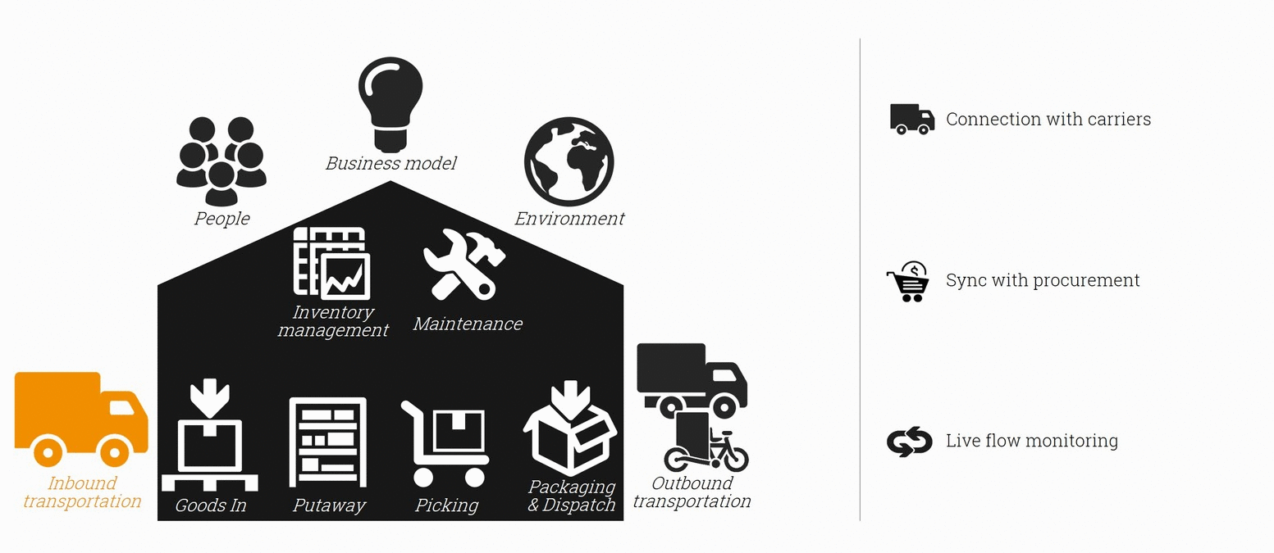
PROPOSED SOLUTION
To solve this problem we proposed a solution that includes:-
A Machine Learning model that performs predictions using five different algorithms built in IBM Watson Studio.
2. A Web Application that serves as the user interface to interact with the Machine Learning Model.

Slide 4



EXPERIMENTAL INVESTIGATIONS
In this process of developing the project we have gone through various investigation processes to learn and understand new concepts so that we can build the optimized warehouse management system model and application successfully. For this we had to learn and investigate the following:
IBM Cloud
IBM Watson Studio
IBM Machine Learning
ZOHO Writer
Different Machine Learning Algorithms
Streamlit and Flask Web Application
Deploying the Web Application on IBM Cloud
GITHUB Repository

Slide 5

MACHINE LEARNING MODEL
For building the machine learning model we use the following algorithms for predicting the number of orders:-
LINEAR REGRESSION
2. DECISION TREE REGRESSION
3. KNEIGHBORS REGRESSION
4. GRADIENT BOOSTING REGRESSION
5. LIGHT GBM REGRESSION

Slide 6

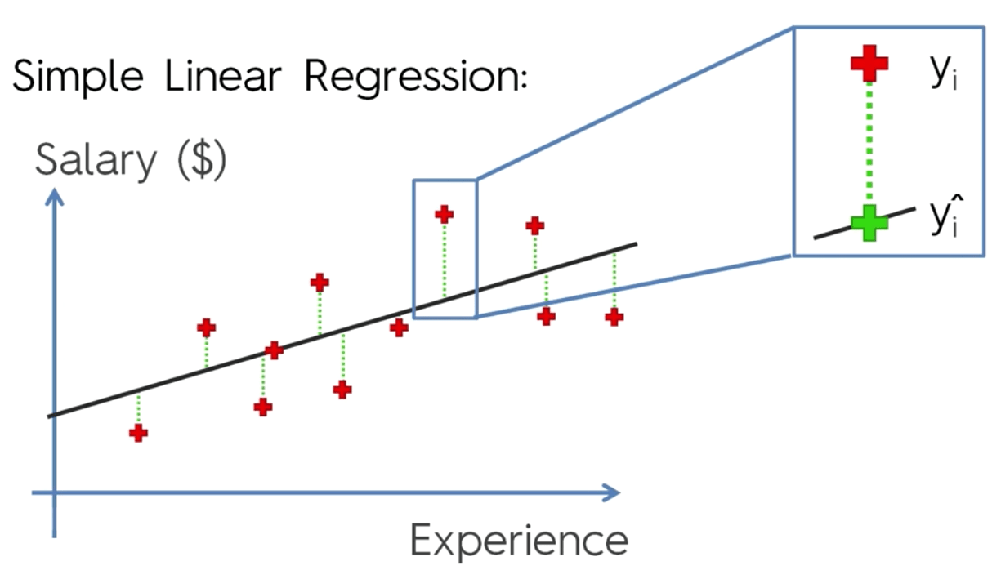
LINEAR REGRESSION
In statistics, linear regression is a linear approach to modeling the relationship between a scalar response (or dependent variable) and one or more explanatory variables (or independent variables). The case of one explanatory variable is called simple linear regression. For more than one explanatory variable, the process is called multiple linear regression.

Slide 7
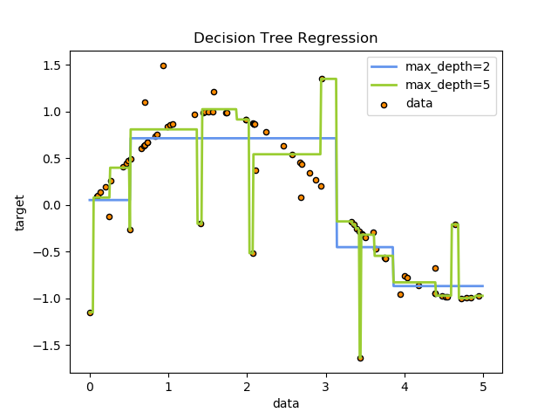
DECISION TREE REGRESSION
Decision tree learning is one of the predictive modelling approaches used in statistics, data mining and machine learning. It uses a decision tree (as a predictive model) to go from observations about an item (represented in the branches) to conclusions about the item's target value (represented in the leaves).

Slide 8
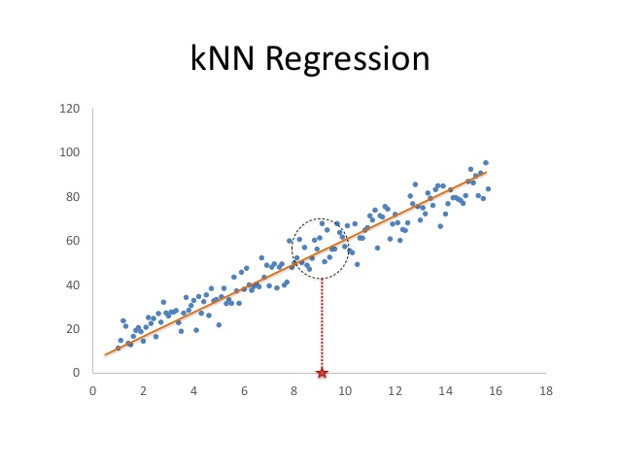
K NEAREST NEIGHBOR REGRESSION
In pattern recognition, the k-nearest neighbors algorithm (k-NN) is a non-parametric method proposed by Thomas Cover used for classification and regression. In both cases, the input consists of the k closest training examples in the feature space.

Slide 9
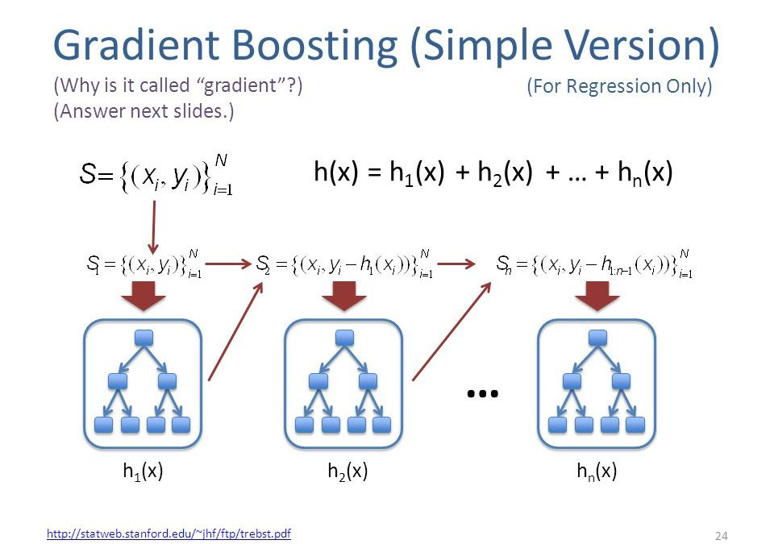
GRADIENT BOOSTING REGRESSION
Gradient boosting is a machine learning technique for regression and classification problems, which produces a prediction model in the form of an ensemble of weak prediction models, typically decision trees. It builds the model in a stage-wise fashion like other boosting methods do, and it generalizes them by allowing optimization of an arbitrary differentiables.

Slide 10
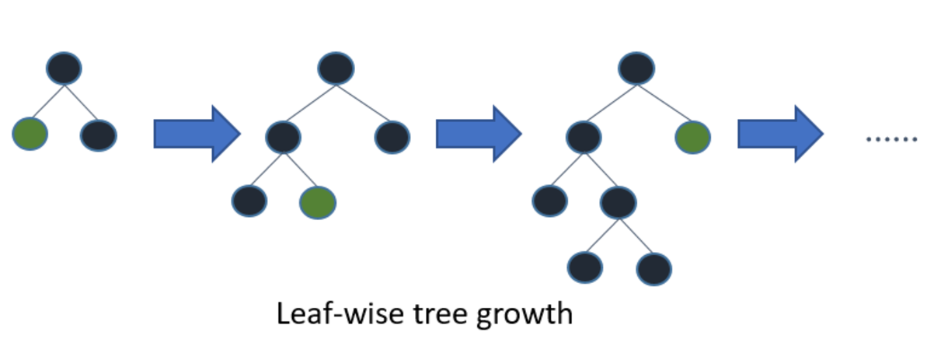
LIGHT GBM REGRESSION
Light GBM is a gradient boosting framework that uses tree based learning algorithm.
How it differs from other tree based algorithm?
Light GBM grows tree vertically while other algorithm grows trees horizontally meaning that Light GBM grows tree leaf-wise while other algorithm grows level-wise. It will choose the leaf with max delta loss to grow. When growing the same leaf, Leaf-wise algorithm can reduce more loss than a level-wise algorithm.

Slide 11
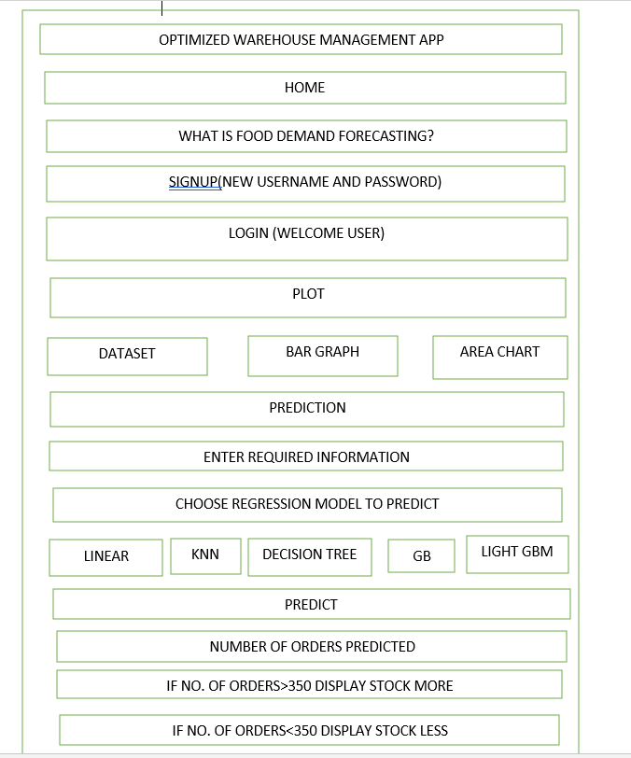
THE USER INTERFACE
A Web Application built using Streamlit on Python.

Slide 12
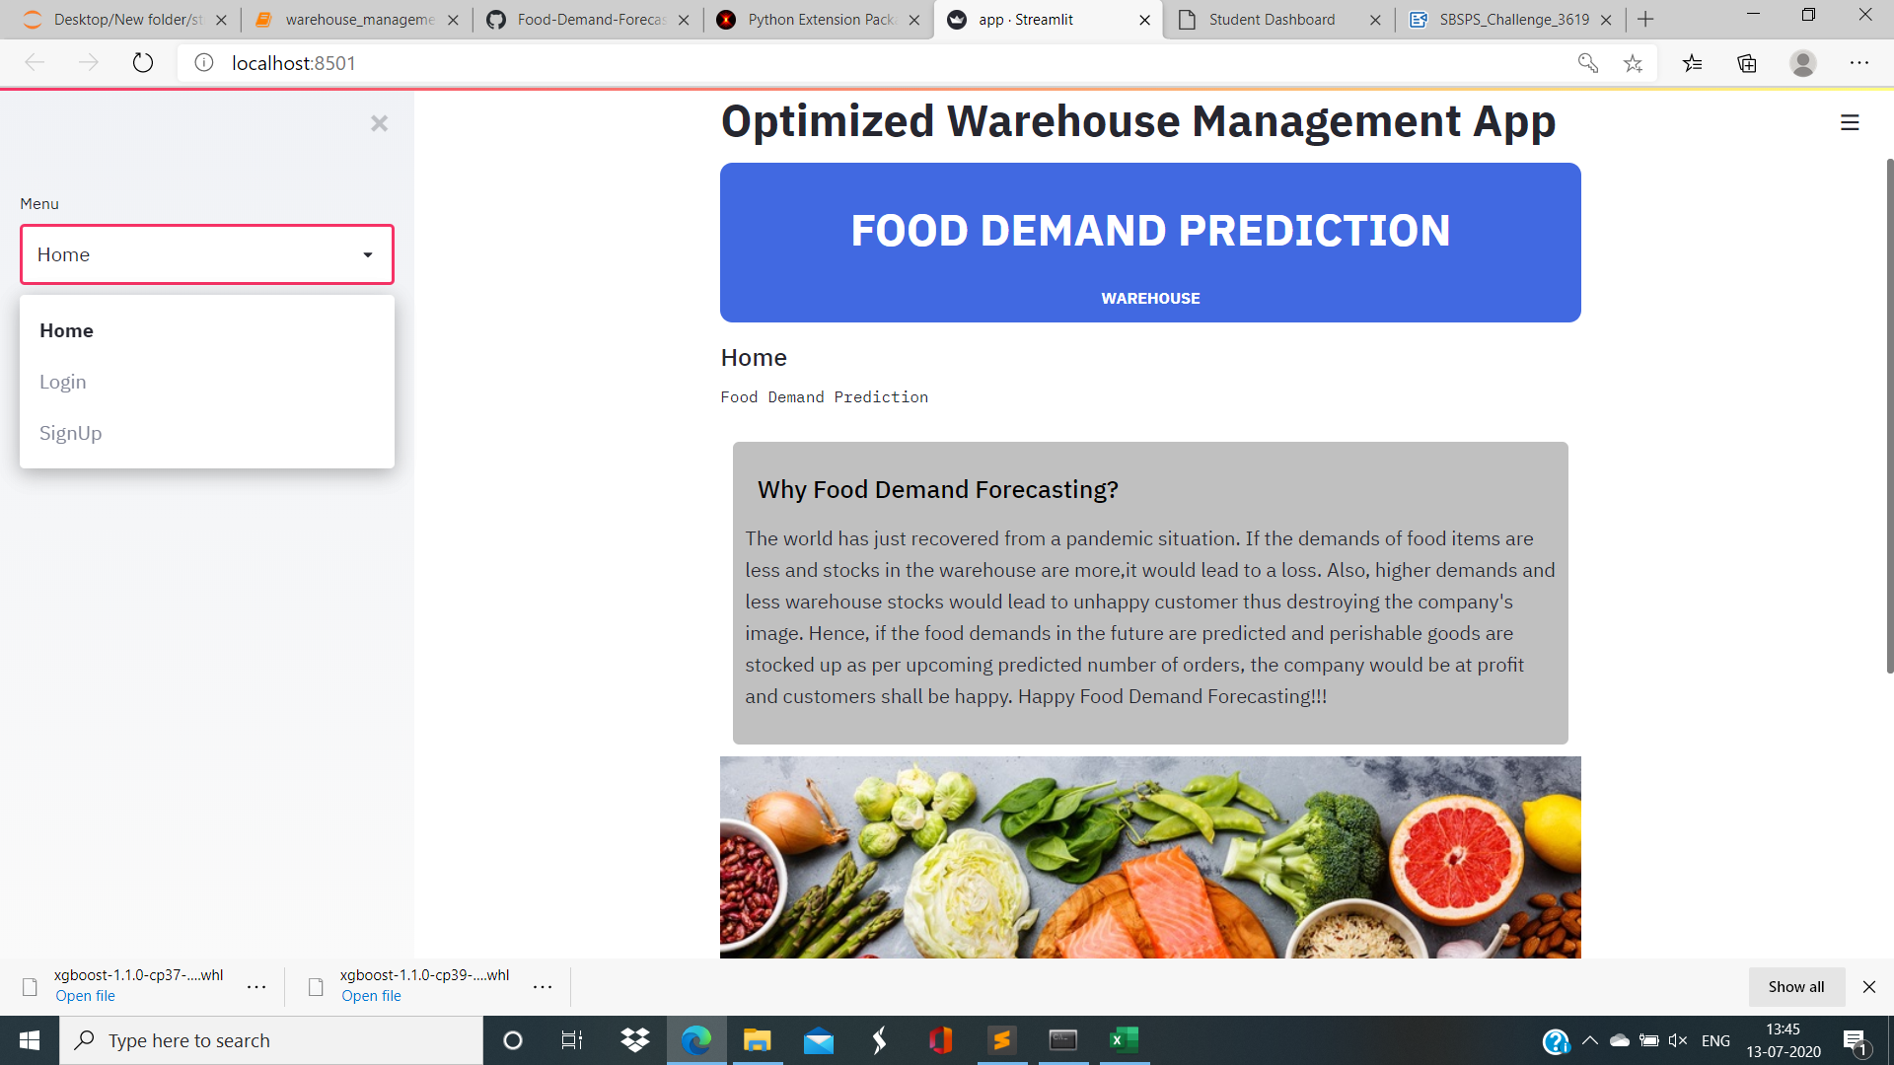
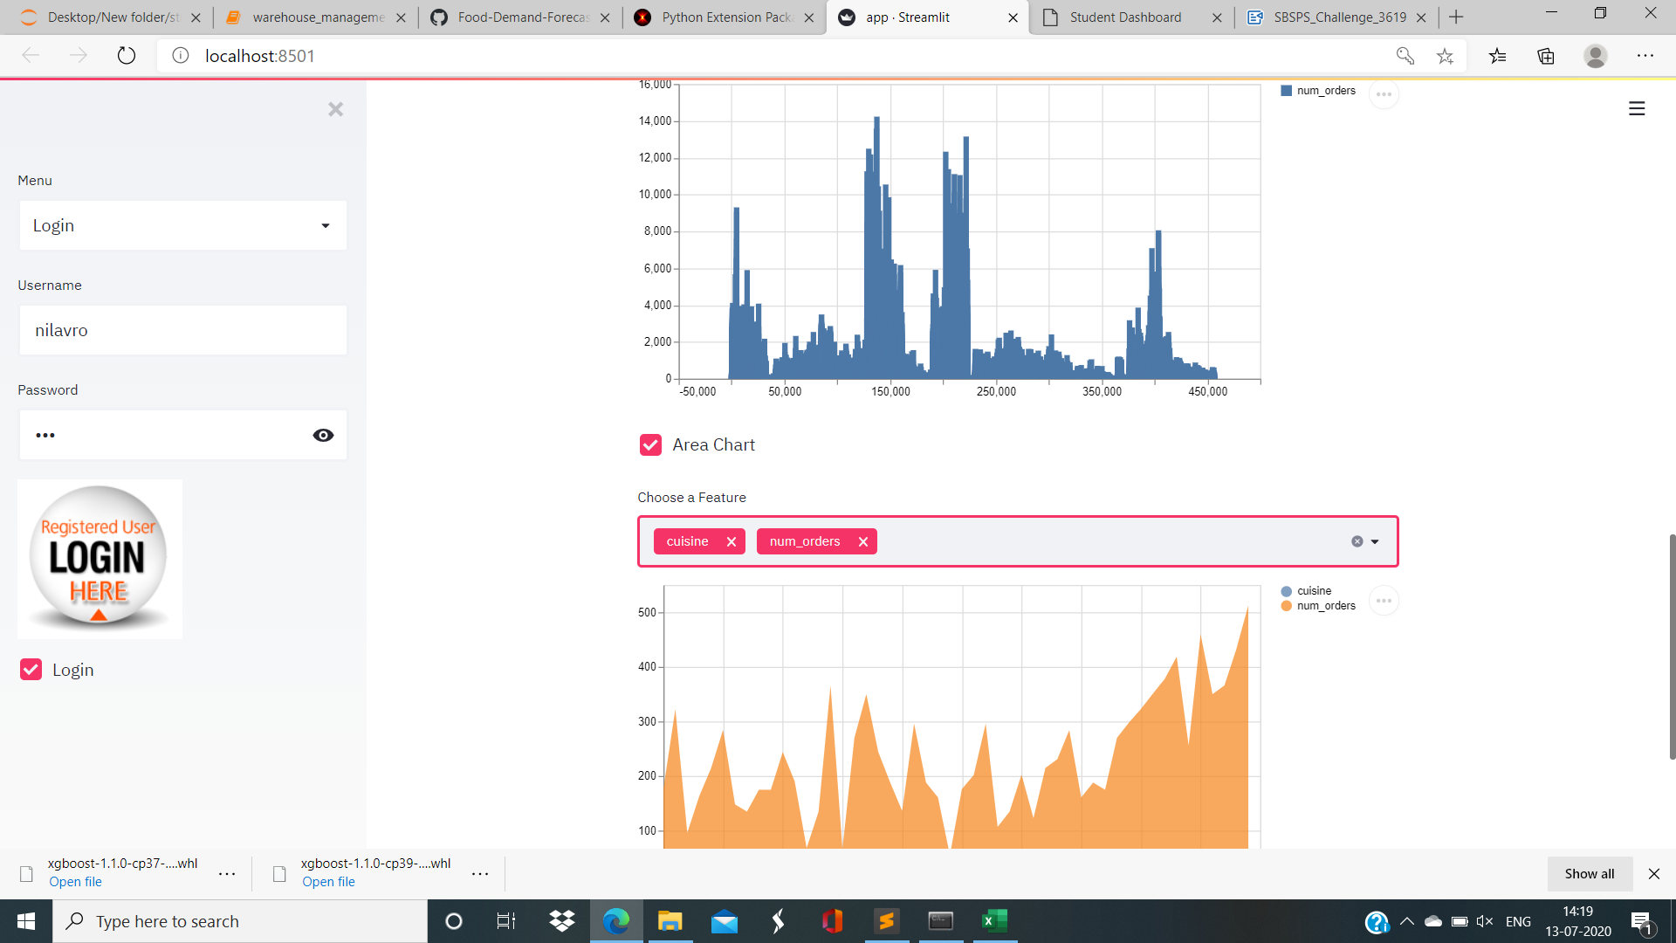
SOME GLIMPSES OF THE WEB APPLICATION

Slide 13
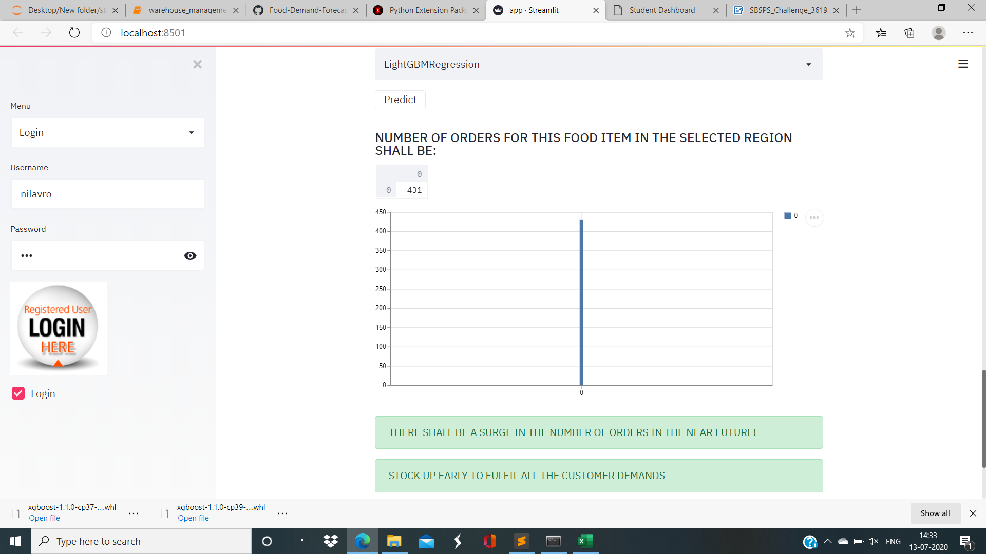
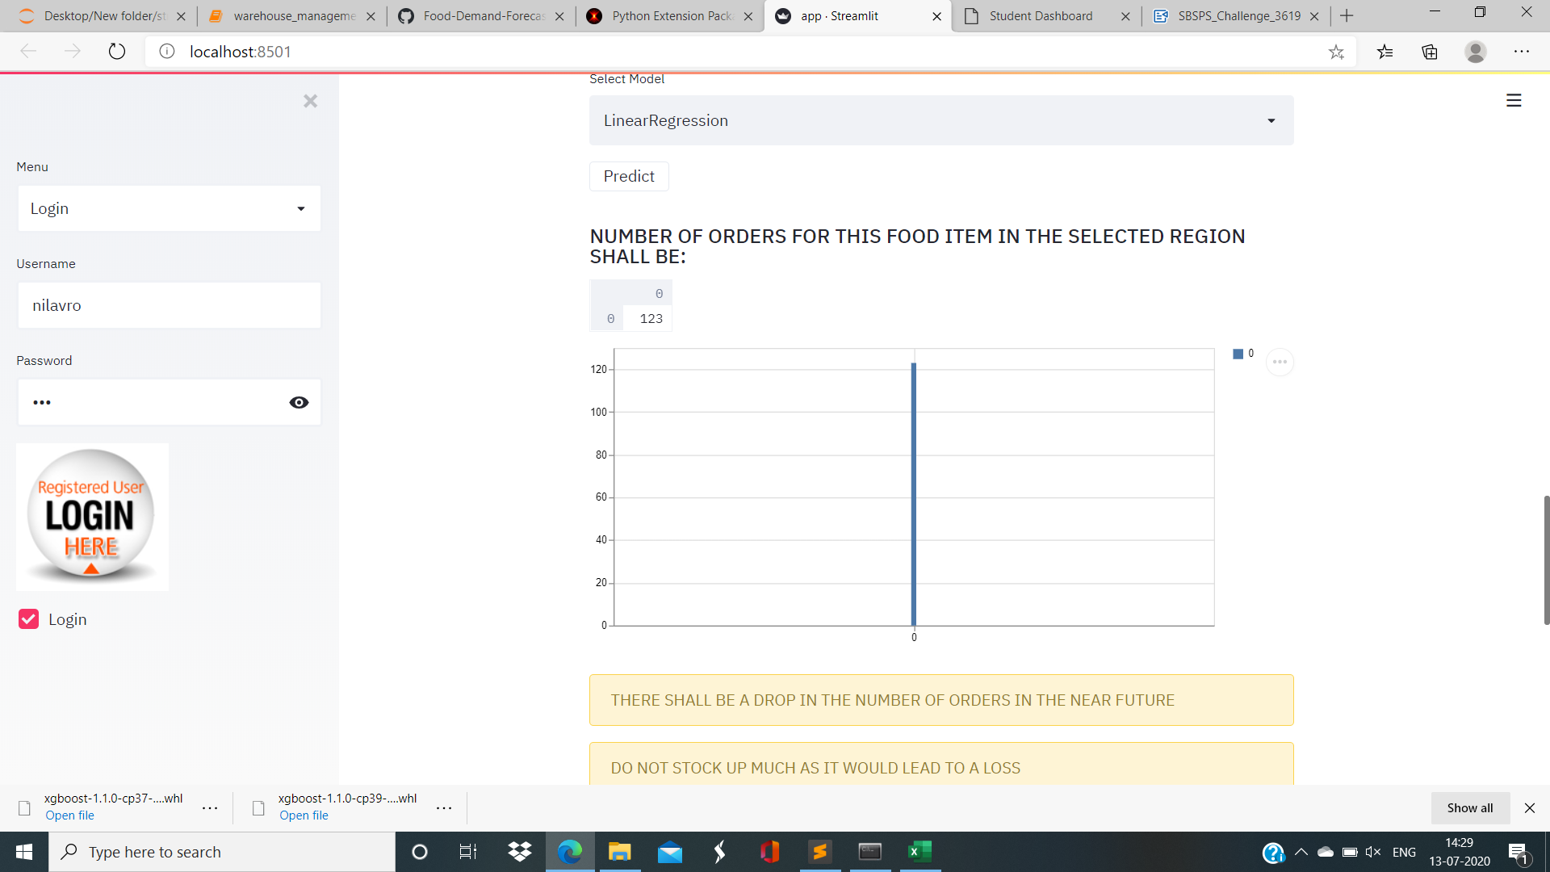

Slide 14

ADVANTAGES
The Optimized Warehouse Management System includes the following advantages:-
The number of orders are predicted using a Machine Learning Model that uses five different algorithms- Linear Regression, Decision Tree Regression, KNeighbors Regession, Gradient Boosting Regression and Light GBM Regression thus increasing the accuracy of the predicted number of orders.
The Warehouse manager can stock up the warehouse as per the predicted number of orders. This would reduce the chances of loss to the food delivery company due to excessive stocks or due to less stocks.
The User Interface is very user-friendly and interactive that allows any user to check the demands on his own.
The Web Application is secured by a password which means that only authorized users can create an account and Login to the web App.
IBM Cloud offers a variety of services with a pay as-you-go structure.

Slide 15

DISADVANTAGES
Forecasts are not 100 percent accurate.
The process can be a bit time-consuming and resource intensive.
It might be a bit costly too.

Slide 16

CONCLUSION
The project gave us some basic working knowledge about IBM Cloud, Watson Studio and shows how to deploy streamlit and flask apps on IBM Cloud platform. It gave us knowledge on how to predict the number of orders using various Machine Learning Models on real datasets. It also taught us how to build an User Interface to interact with the Machine Learning Model.

Slide 17

FUTURE SCOPE
This project can be integrated to other web applications as this application can be used as a submodule to other big applications. Since this project includes Machine Learning from IBM Watson studio it will help the user to understand the number of orders in his warehouse in future and prevent loss of the food delivery company.

Slide 18
BIBLIOGRAPHY
Names:- Shreyoshi Mukherjee, Nilovra Saha, Mayukh Banerjee
College Name:- University of Engineering and Management, Kolkata.
Work Title- Optimized Warehouse Management of Perishable Goods for a Food Delivery Company.
References:-
https://www.scnsoft.com/blog/demand-forecasting-with-data-science
https://www.kaggle.com/kannanaikkal/food-demand-forecastingc. https://www.youtube.com/watch?v=VzPp1MgsTnc&feature=youtu.behttps://www.youtube.com/watch?v=IAcY7UGUL4I&t=9184s

Slide 19


